Slide 1

HELLO WORLD: YOUR FIRST PROGRAM
CHAPTER 18

Slide 2
Topics
Hello World?
Creating a Unity Project
  The Unity Project Folder
MonoDevelop: Unity's Code Editor
Attaching Scripts to GameObjects
Start() and Update()
GameObject Prefabs and Instantiation
The HelloWorld Project

Slide 3
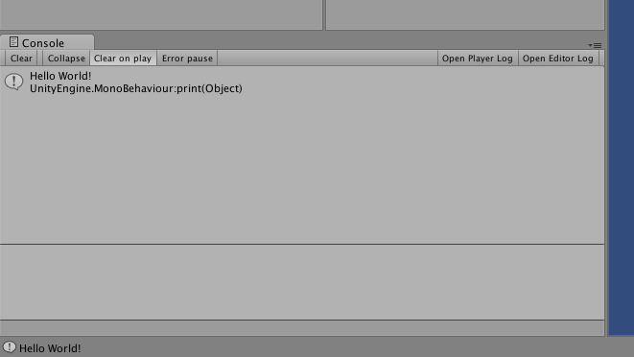
Hello World?
Hello World is often the first program written by anyone learning a new programming language.
Outputs "Hello World!" to the Console

Slide 4
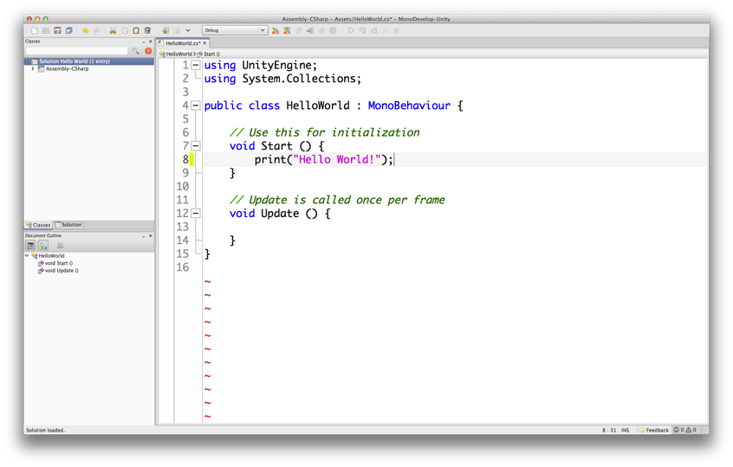
Hello World?
The code of HelloWorld.cs is very simple:

Slide 5
Creating a Unity Project
From the menu bar, choose File > New Project…
Choose the location for your project folder
  Mac OS X
    Click the Set… button
    Navigate to the right location
    Type the project name into the Save As field
    Click the Save button
  Windows
    Click the Browse… button
    Navigate to the right location
    Click the New Folder button and give the new folder the name of your project.
    Click the Select Folder button

Slide 6
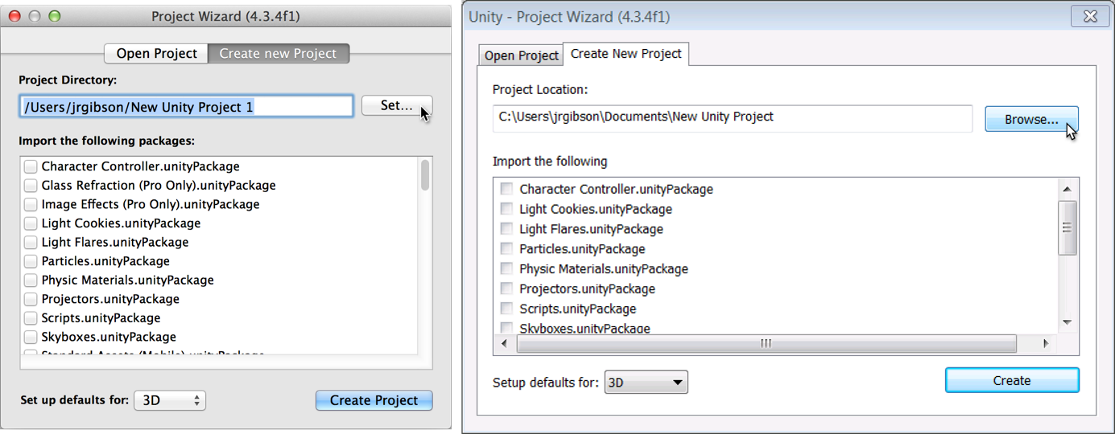
Creating a Unity Project
Set up defaults for 3D
Click the Create Project or Create button
Appendix A contains detailed instructions

Slide 7
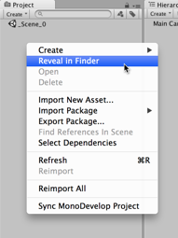
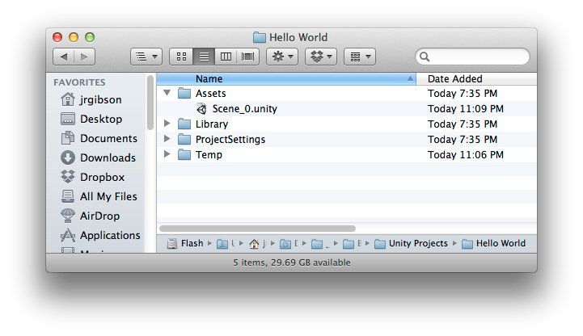
Creating a Unity Project
The Project pane shows the contents of the Assets folder inside your Unity project folder
  Right-click in the Project pane and choose Reveal in Finder (or Show in Explorer) from the pop-up menu

Slide 8
MonoDevelop: Unity's Code Editor
Unity uses MonoDevelop for code editing
  MonoDevelop is a separate program developed by a different team
To open MonoDevelop, double-click any C# script in your Project pane
  This will launch MonoDevelop
  Though the launch process takes some time
You must save a document in MonoDevelop for it to recompile and update in Unity
On Windows, Microsoft Visual Studio may be used
  Instructions for this can be found online

Slide 9
MonoDevelop: Unity's Code Editor
Classes
Pane
Document
Outline
Pane
Code Pane
The MonoDevelop Window

Slide 10
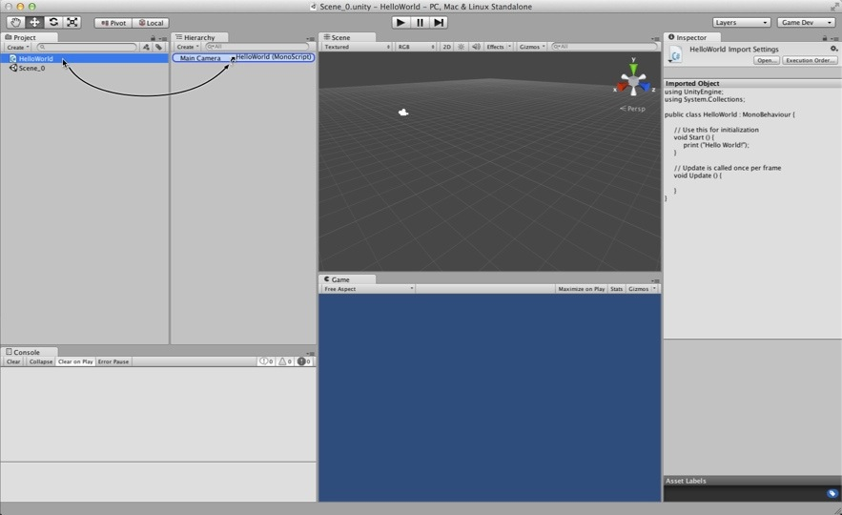
Attaching Scripts to GameObjects
To work in Unity, a C# script must be attached to a GameObject

Slide 11
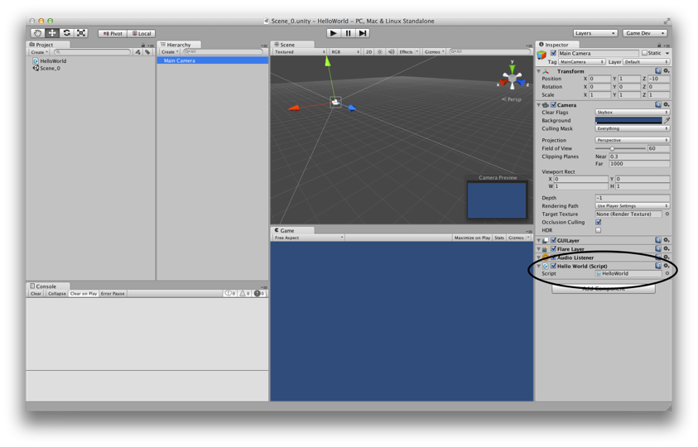
Attaching Scripts to GameObjects
This makes the script a component of the GameObject

Slide 12
Start() and Update()
You make use of Start() and Update() in the HelloWorld project
  void Start() {…}
    Called once
    Called immediately before the first Update() is called
  void Update() {…}
    Called every frame
    This can happen over 200 times per second!
  void Awake() {…} (not used in HelloWorld, but important)
    Called once
    Called at the moment the GameObject is created
    Guaranteed to be called before Start()

Slide 13
GameObject Prefabs and Instantiation
A prefab is a mold from which GameObject instances can be made
  Created by dragging a GameObject from the Hierarchy pane into the Project pane
  Can be assigned to a script variable in the Inspector pane
    public GameObject gameObjectPrefab;
  Then, an instance of the prefab can be created in code
    Instantiate( gameObjectPrefab );
This is used in HelloWorld to create thousands of instances of a Cube GameObject prefab

Slide 14
The HelloWorld Project
Output "Hello World!" to the Console pane
  Once using Start()
  Many times using Update()
Create a Cube prefab that reacts to gravity & physics
Instantiate an instance of the Cube prefab
  Once using Start()
  Many times using Update()
    This will create a cascade of thousands of Cube instances
  Over other physically-modeled objects

Slide 15
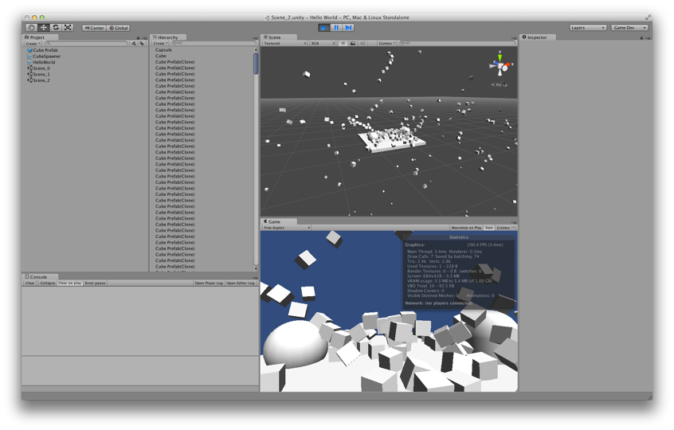
The HelloWorld Project
The final HelloWorld scene

Slide 16
Chapter 18 – Summary
Hello World is a common first program to make in any new language
Unity projects are stored as many files in project folders on your hard drive
MonoDevelop is used to edit code for Unity
Scripts must be attached to GameObjects to run
Start(), Update(), and Awake() are called at different times and have different uses
GameObject prefabs can be instantiated many times

